Slide 1
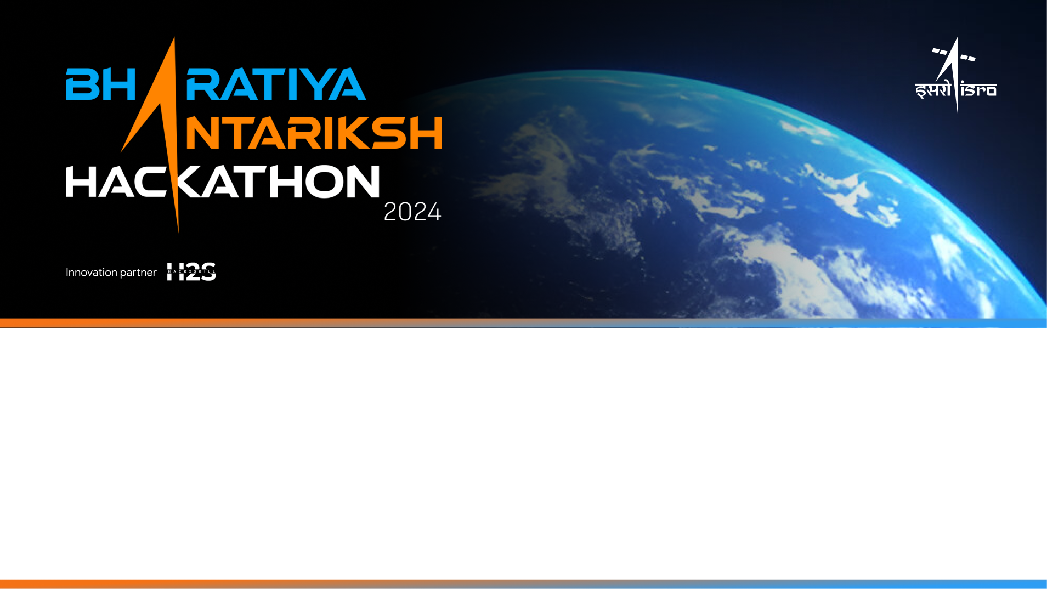
Team Name: Avishkar
Name of College(s)/University(s): Rajeev Gandhi Memorial College of Engineering and Technology
Team Members Details:
Team Member-1 Koilakonda Madhu
Team Member-2 Midde Mohammad Anees
Team Member-3 Dagudu Sai Kumar

Slide 2

Automatic detection of craters and boulders in Orbiter High Resolution Camera (OHRC) images is a well-suited application for Artificial Intelligence (AI) and Machine Learning (ML) techniques. These techniques can significantly improve efficiency and accuracy compared to manual analysis. Here's a breakdown of the approach:
Techniques:
Deep Convolutional Neural Networks (CNNs): This is a powerful approach for image recognition. CNNs can be trained on large datasets of OHRC images containing labeled craters and boulders. The network learns to identify the characteristic features of these objects, such as circular shapes for craters and high contrast for boulders, even in varying lighting conditions.
Object Detection Algorithms: Once a CNN is trained to identify craters and boulders, object detection algorithms like YOLO (You Only Look Once) or SSD (Single Shot MultiBox Detector) can be used to pinpoint their location and size within the image. These algorithms predict bounding boxes around the objects in the image.
Challenges:
Data Availability: Training a robust AI model requires a large dataset of labeled OHRC images. This can be a challenge as manual labeling is time-consuming. Techniques like data augmentation (artificially creating variations of existing data) can help mitigate this.
Image Variations: OHRC images can have variations in illumination, resolution, and background texture. The model needs to be trained to be robust to these variations to avoid false positives and negatives.
Additional Information: Existing Research: There's ongoing research in this field. Studies have shown success in using CNNs for automated lunar crater identification from similar high-resolution imagery [1].
Benefits: Automating crater and boulder detection saves time and resources compared to manual analysis. It also allows for more comprehensive analysis of larger datasets.
Conclusion: AI/ML offers a powerful approach for automatic crater and boulder detection in OHRC images. By overcoming data challenges and incorporating robust algorithms, this technology can significantly enhance planetary science research and exploration missions.

Slide 3
Tools and Technology Used:
Based on the image you sent, the text says "Tools and Technology Used (50 words)" but there are no details listed within the image itself. In general, AI and Machine Learning (ML) techniques are commonly used for automatic detection of craters and boulders from Orbiter High Resolution Camera (OHRC) images. Deep Convolutional Neural Networks (CNNs) are a powerful approach for image recognition in this context. CNNs can be trained on large datasets of OHRC images containing labeled craters and boulders. The network learns to identify the characteristic features of these objects, such as circular shapes for craters and high contrast for boulders, even in varying lighting conditions. Object detection algorithms like YOLO or SSD can then be used to pinpoint the location and size of these objects within the image.

Slide 4
Opportunity
Based on the text in the image, it isn't possible to say exactly how different this proposed solution is from other existing ideas for crater and boulder detection in OHRC images. However, here's what we can generally say about using AI/ML for this task:
Existing Solutions: Current methods likely rely on manual analysis or traditional image processing techniques to identify craters and boulders. These methods can be time-consuming and may not be as accurate, especially for large datasets.
AI/ML Approach: This approach leverages machine learning models trained to automatically detect craters and boulders based on image features. This can significantly improve efficiency and potentially accuracy compared to manual methods.
How it Solves the Problem:
Automatic detection saves time and resources compared to manual analysis of OHRC images.
AI models can potentially identify faint craters or subtle variations in boulder shapes that might be missed by human analysis.
Large datasets can be analyzed comprehensively to identify patterns or statistical information about crater and boulder distribution.
USP (Unique Selling Point):The USP of this solution would depend on the specifics of the proposed AI/ML model and how it addresses the challenges of crater and boulder detection in OHRC images. Here are some potential differentiators:

Slide 5
Opportunity
Large datasets can be analyzed comprehensively to identify patterns or statistical information about crater and boulder distribution.
Higher Accuracy: The model might achieve a higher accuracy in crater and boulder detection compared to existing methods. *
Improved Generalizability: The model might be designed to perform well on a wider variety of OHRC image data than other solutions.
Reduced Training Data: The solution might require less labeled training data to achieve good performance, making it more cost-effective. Without more details about the proposed solution, it's difficult to say for sure what its unique selling proposition would be.
USP (Unique Selling Point): The USP of this solution would depend on the specifics of the proposed AI/ML model and how it addresses the challenges of crater and boulder detection in OHRC images. Here are some potential differentiators:
Higher Accuracy: The model might achieve a higher accuracy in crater and boulder detection compared to existing methods.
Improved Generalizability: The model might be designed to perform well on a wider variety of OHRC image data than other solutions.
Reduced Training Data: The solution might require less labeled training data to achieve good performance, making it more cost-effective. Without more details about the proposed solution, it's difficult to say for sure what its unique selling proposition would be.

Slide 6
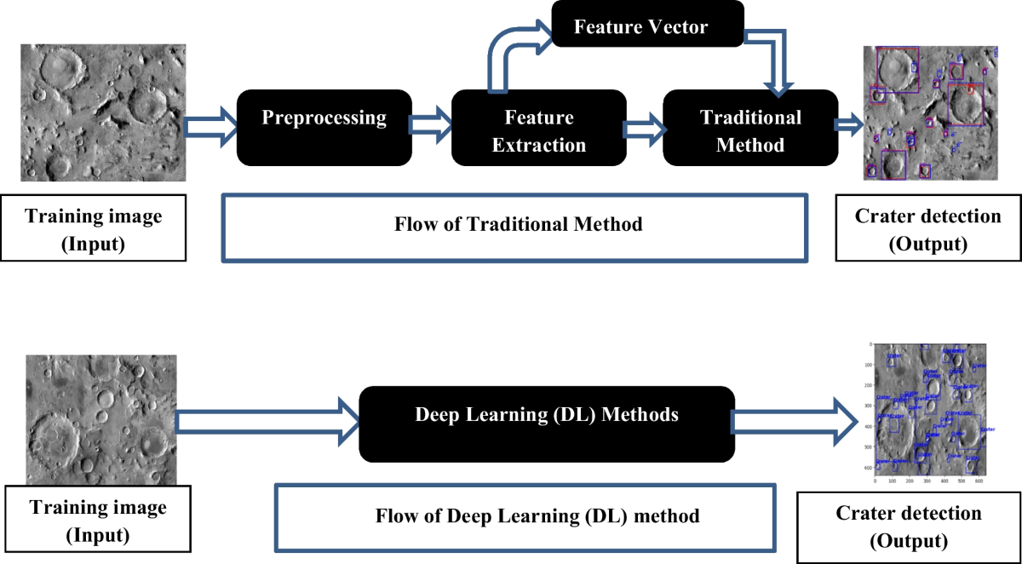
Proposed architecture/user diagram

Slide 7
Features of AI-powered Crater and Boulder Detection in OHRC Images
Features:
1. Automatic Crater and Boulder Detection:
The core functionality is automatic identification of craters and boulders in OHRC images. This eliminates the need for manual analysis, saving significant time and resources. (Imagine a sketch of a computer screen displaying an OHRC image with red circles highlighting craters and blue squares around boulders)
2. High Accuracy: By leveraging deep learning models, the solution can achieve high accuracy in detection, potentially surpassing traditional methods. (Sketch a graph with "Accuracy" on the Y-axis and "Detection Methods" on the X-axis with a line representing AI/ML surpassing other methods)
3. Scalability: The system can handle large datasets of OHRC images efficiently, enabling analysis of vast areas or long-term studies. (Sketch a large archive overflowing with OHRC images being fed into the AI system)
4. Data Analysis: The solution can provide insights beyond basic detection. Analyze crater size distribution, boulder density across regions, or identify potential landing sites based on crater characteristics. (Sketch a pie chart showing crater size distribution and a map highlighting areas with high boulder density)
5. Customization: The AI model can be fine-tuned to specific needs. Focus on detecting craters of a particular size range or prioritize boulder identification based on composition. (Sketch dials and levers on the computer screen allowing adjustments to the AI model)
6. Visualization Tools: The system can present results in user-friendly formats. Generate reports with detailed information or create overlay maps highlighting detected features. (Sketch a scientist reviewing a report with tables and graphs alongside a map overlaid with crater and boulder locations)
Benefits of Visuals: Adding sketches or illustrations can significantly enhance your presentation. Visuals make complex information easier to understand, improve audience retention, and add a professional touch.

Slide 8
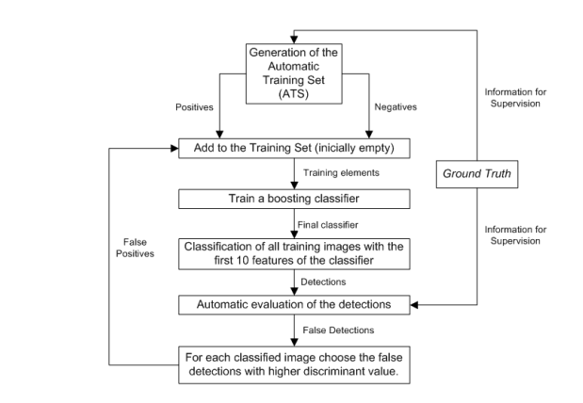
Process flow diagram

Slide 9
Automatic Crater and Boulder Detection in OHRC Images: A Solution Brief
Executive Summary Manually analyzing Orbiter High Resolution Camera (OHRC) images for crater and boulder detection is a laborious task hindering scientific progress. This solution brief proposes an automated approach using Artificial Intelligence (AI) and Machine Learning (ML) techniques. Deep learning models, trained on labeled OHRC data, can identify craters and boulders with high accuracy, significantly improving efficiency and potentially surpassing traditional methods.
Challenge:
Manual Analysis Bottleneck Planetary scientists rely on OHRC images to study celestial surfaces. Identifying craters and boulders within these images is crucial for various purposes, including geological characterization, resource exploration, and mission planning. However, manual analysis suffers from key limitations:
Time-consuming and Laborious: Manually marking craters and boulders in large datasets is tedious and requires significant time investment.
Prone to Inconsistency: Subjectivity can lead to inconsistencies between analysts, particularly for faint craters or subtle variations in boulder shapes.
Limited Scalability: Manual analysis becomes impractical for processing vast datasets of OHRC images.
Solution:
AI/ML-Powered Automation** This solution leverages AI/ML to automate crater and boulder detection in OHRC images. Here's the core approach:
1. Data Preparation: Collect and pre-process OHRC images, including potential labeling for training data. This might involve tasks like resizing, formatting, and labeling craters and boulders for the model to learn from.

Slide 10
2. Model Training: Train a deep learning model on the labeled data. The model, inspired by the human brain's structure and function, learns to identify characteristic features of craters (circular shapes) and boulders (high contrast) within the images.
3. Object Detection: Integrate an object detection algorithm like YOLO (You Only Look Once) or SSD (Single Shot MultiBox Detector) on top of the deep learning model. This allows the model to not only classify craters and boulders but also pinpoint their location and size within the image.
4. Inference: Use the trained model to analyze new OHRC images. The model automatically detects and classifies craters and boulders, significantly reducing manual workload.
Benefits of Automation
Increased Efficiency: Automation saves significant time and resources compared to manual analysis, freeing up scientists for more advanced research tasks.
Improved Accuracy: The model can potentially achieve higher accuracy in detection than manual methods due to its ability to analyze vast amounts of data and identify subtle features.
Enhanced Scalability: The system efficiently handles large datasets of OHRC images, allowing for comprehensive analysis of vast planetary regions.
Data-Driven Insights: Beyond basic detection, the solution can provide valuable insights. Analyze crater size distribution, identify areas with high boulder density, or use crater characteristics to suggest potential landing sites.

Slide 11
Applications
Planetary Science Research: Expedites analysis of OHRC imagery for geological studies, leading to faster scientific discoveries.
Mission Planning: Supports site selection for rovers or landers based on crater and boulder distribution, optimizing mission efficiency and ensuring safe landings.
Resource Exploration: Identifies potential areas of resource concentration based on crater characteristics, aiding in resource discovery efforts.
Conclusion AI/ML offers a powerful solution for automatic crater and boulder detection in OHRC images. By automating this critical task, scientists can unlock the full potential of OHRC imagery, accelerating scientific progress and exploration efforts.
Next Steps Develop a detailed project plan for implementation, outlining resource allocation and timelines.
Collaborate with planetary scientists to refine training data and ensure the solution addresses specific needs of the research community.
Conduct a pilot test on a real-world OHRC image dataset to evaluate the solution's performance and gather user feedback for further refinement. This AI/ML-based solution has the potential to revolutionize how we analyze OHRC images, paving the way for a new era of discovery in planetary science.

Slide 12
